Slide 1
Group project
A Creation BY :
GROUP-6
Gurpreet singh
SABARish
Pankaj Gupta
Sivashankari
Hiren kumar
Anupriya

Slide 2
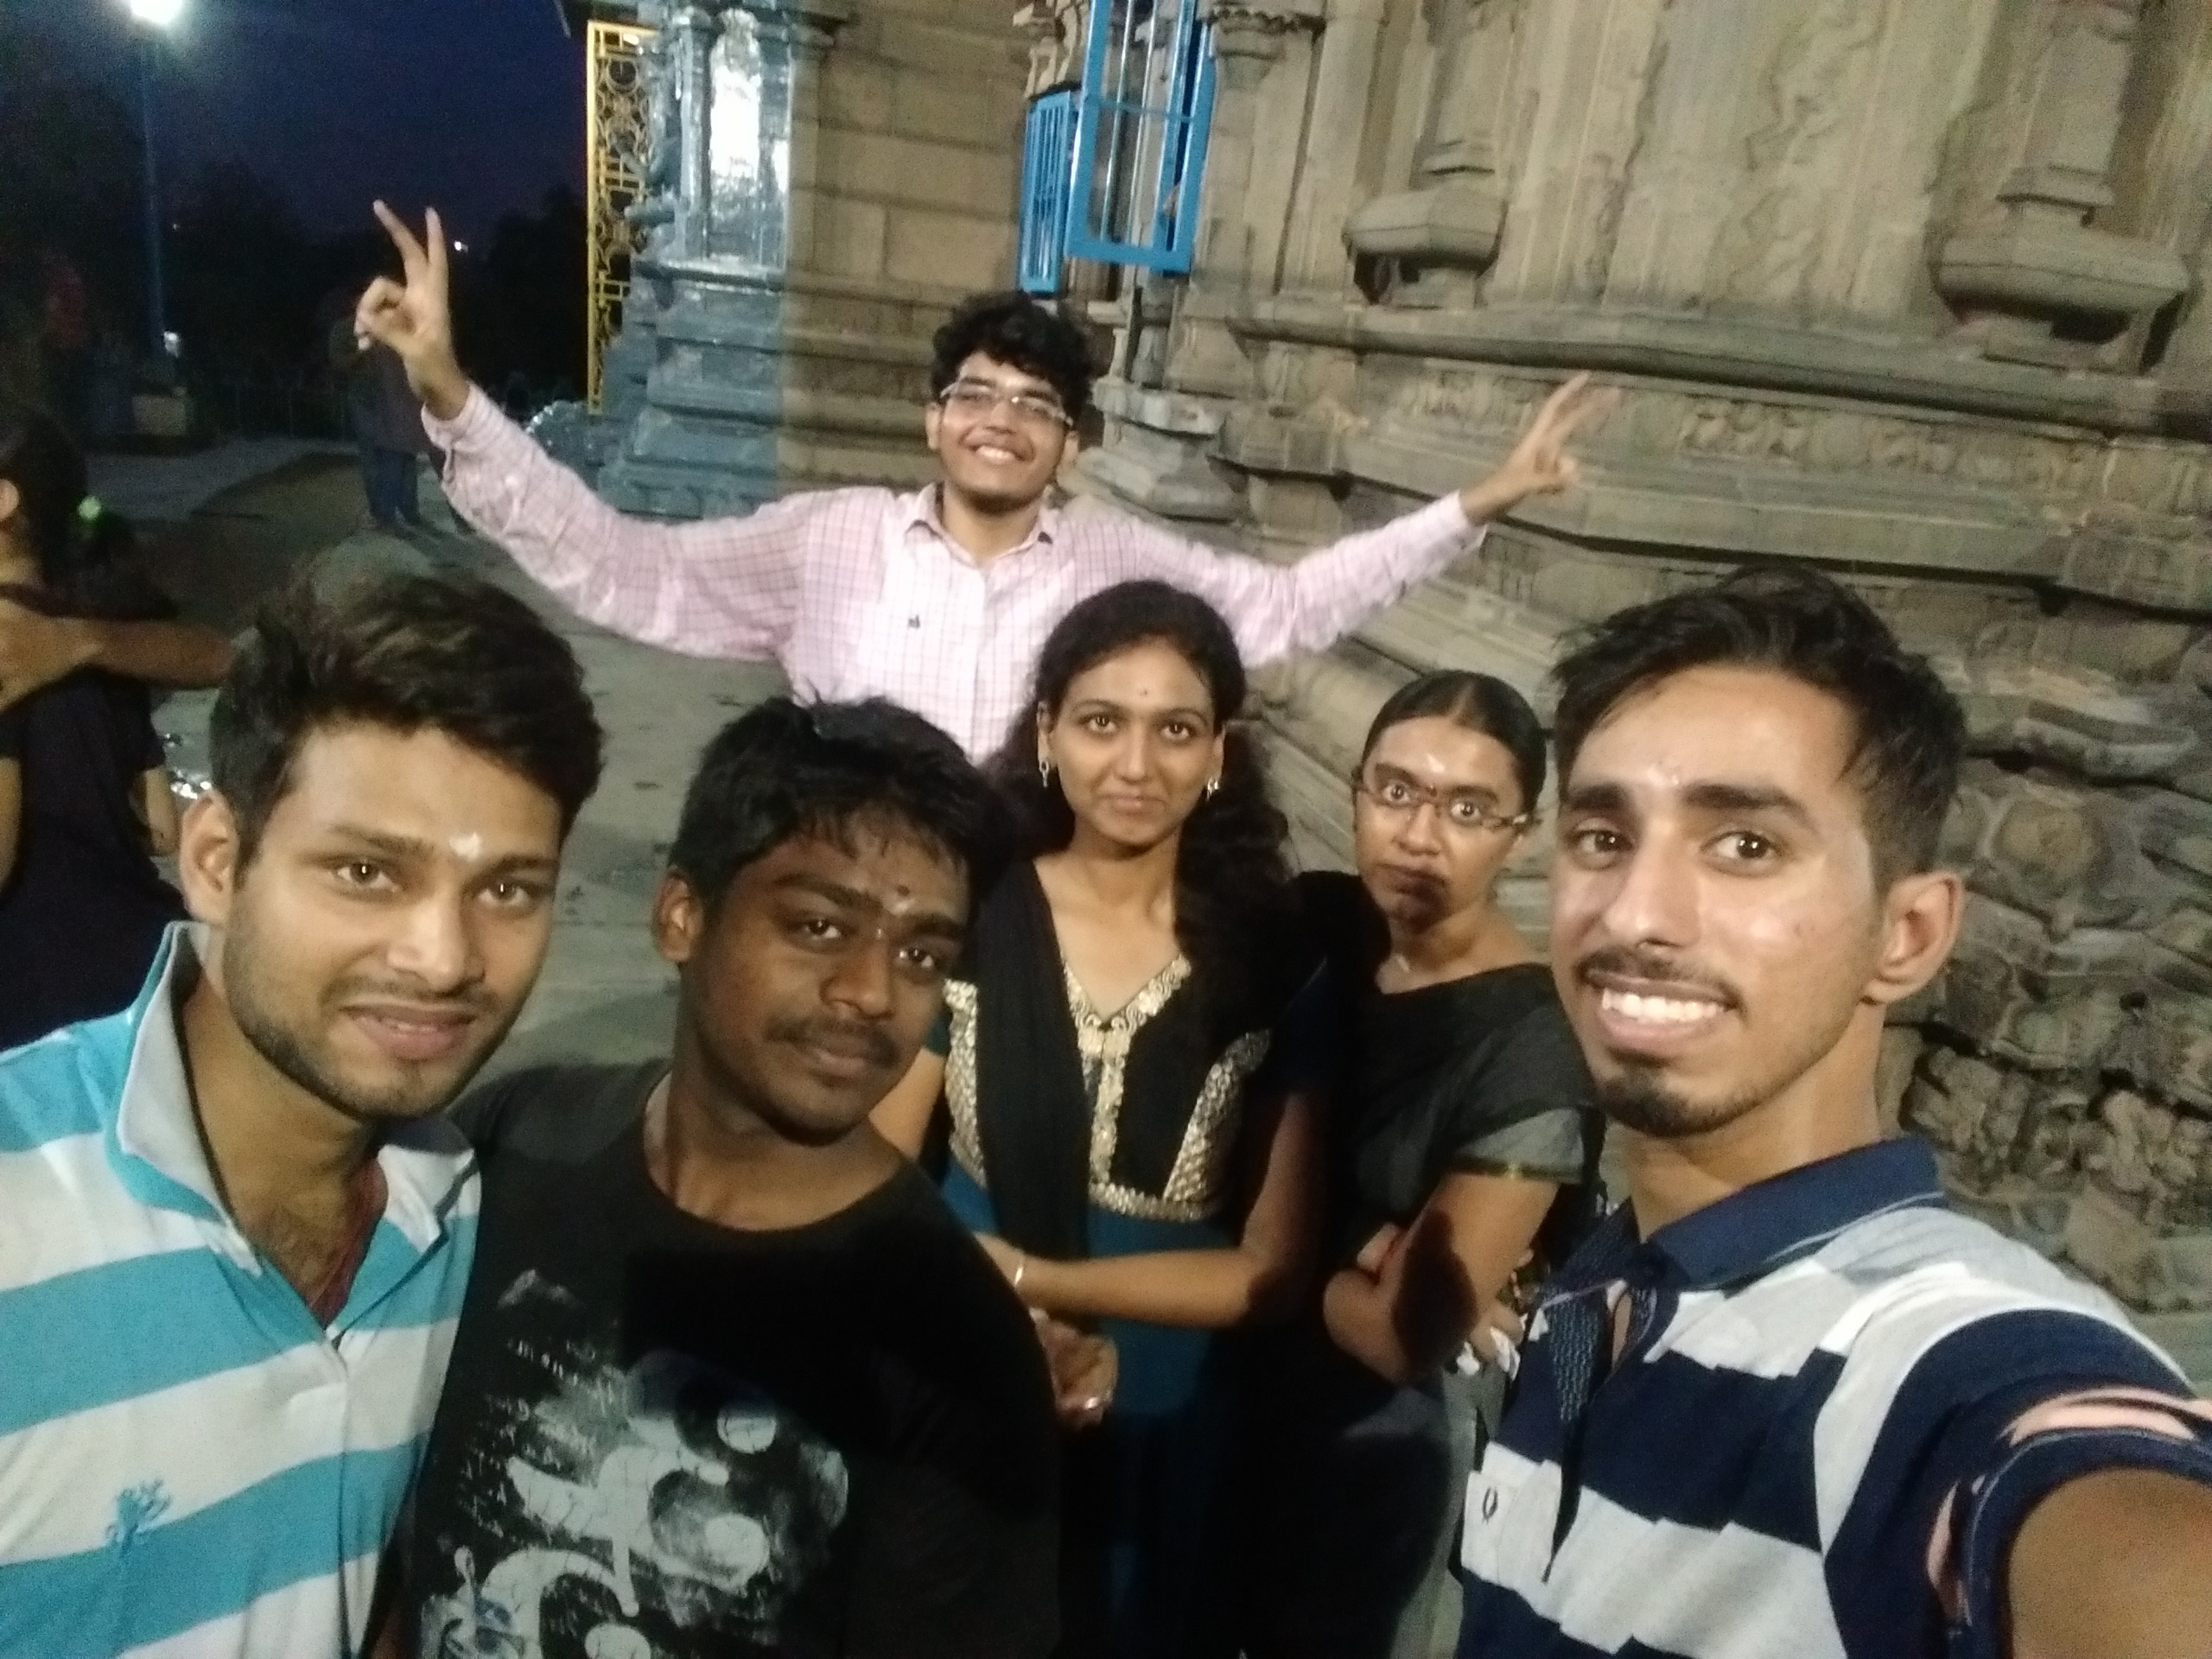
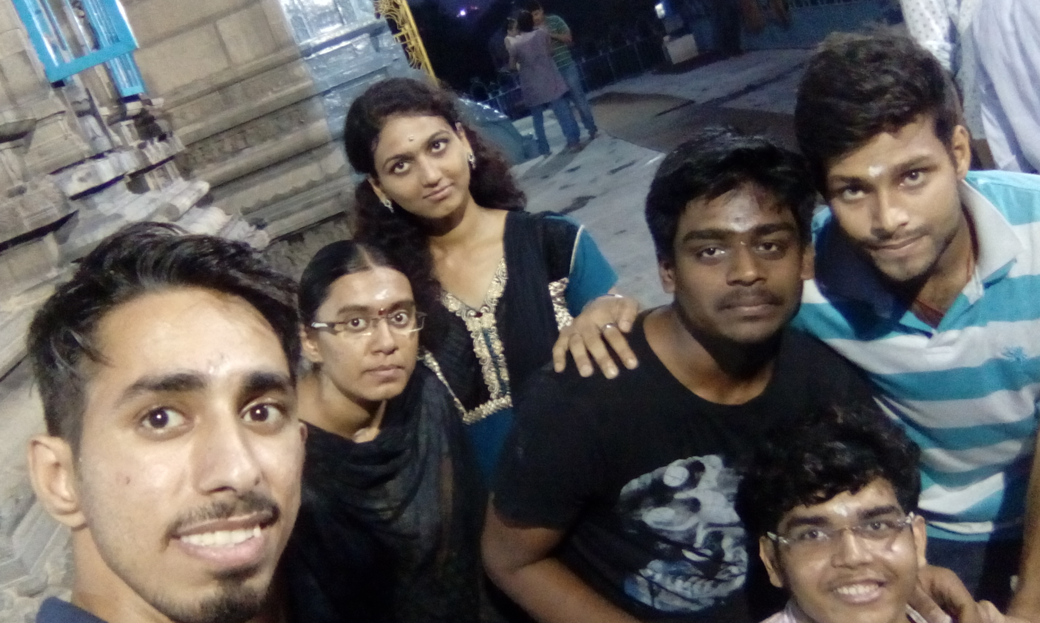
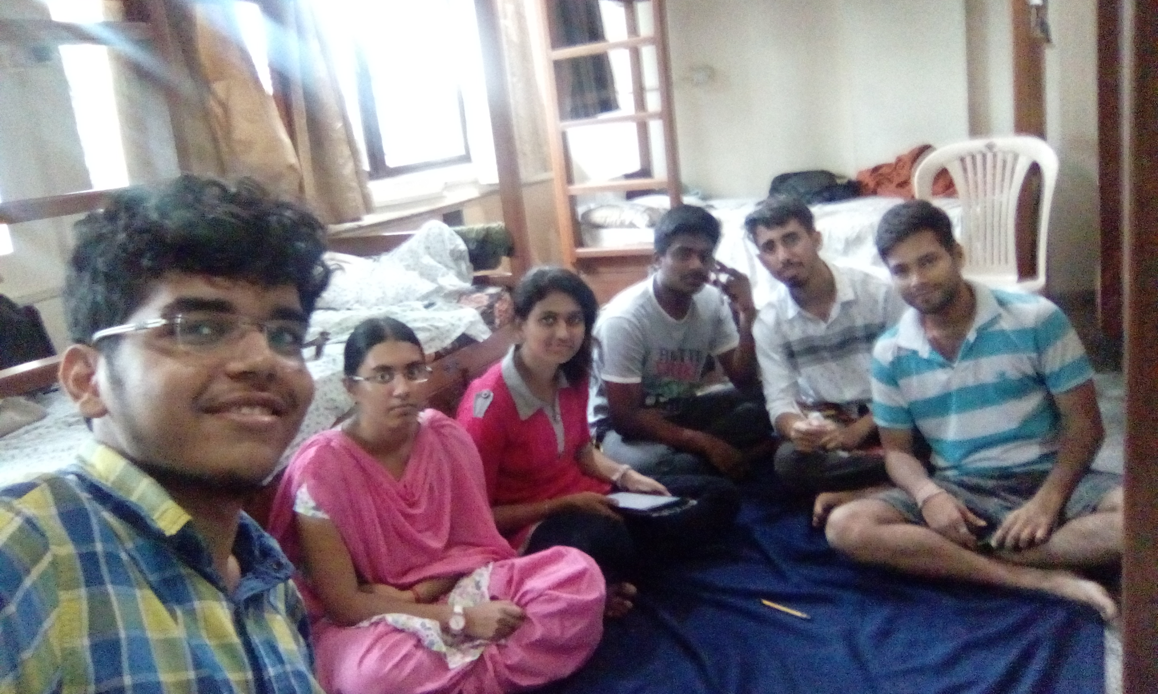
SELFIE TIME

Slide 3
Problem statements
We need to solve payment system problem because of the transactional system.
We need inexpensive umbilical cord preservation system because its alternatives are not affordable.
We need to solve translational problems because people are unable to communicate as they travel.
We need to solve mobile recharge difficulties because of different cellular cards for each recharge system.

Slide 4
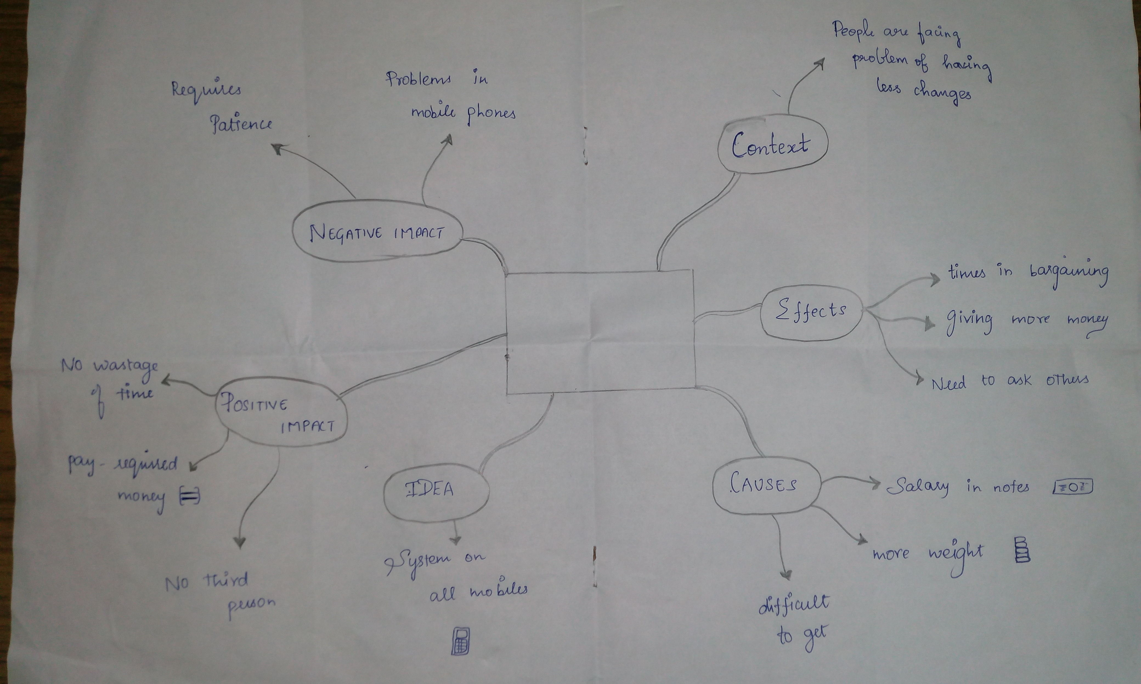

Slide 5
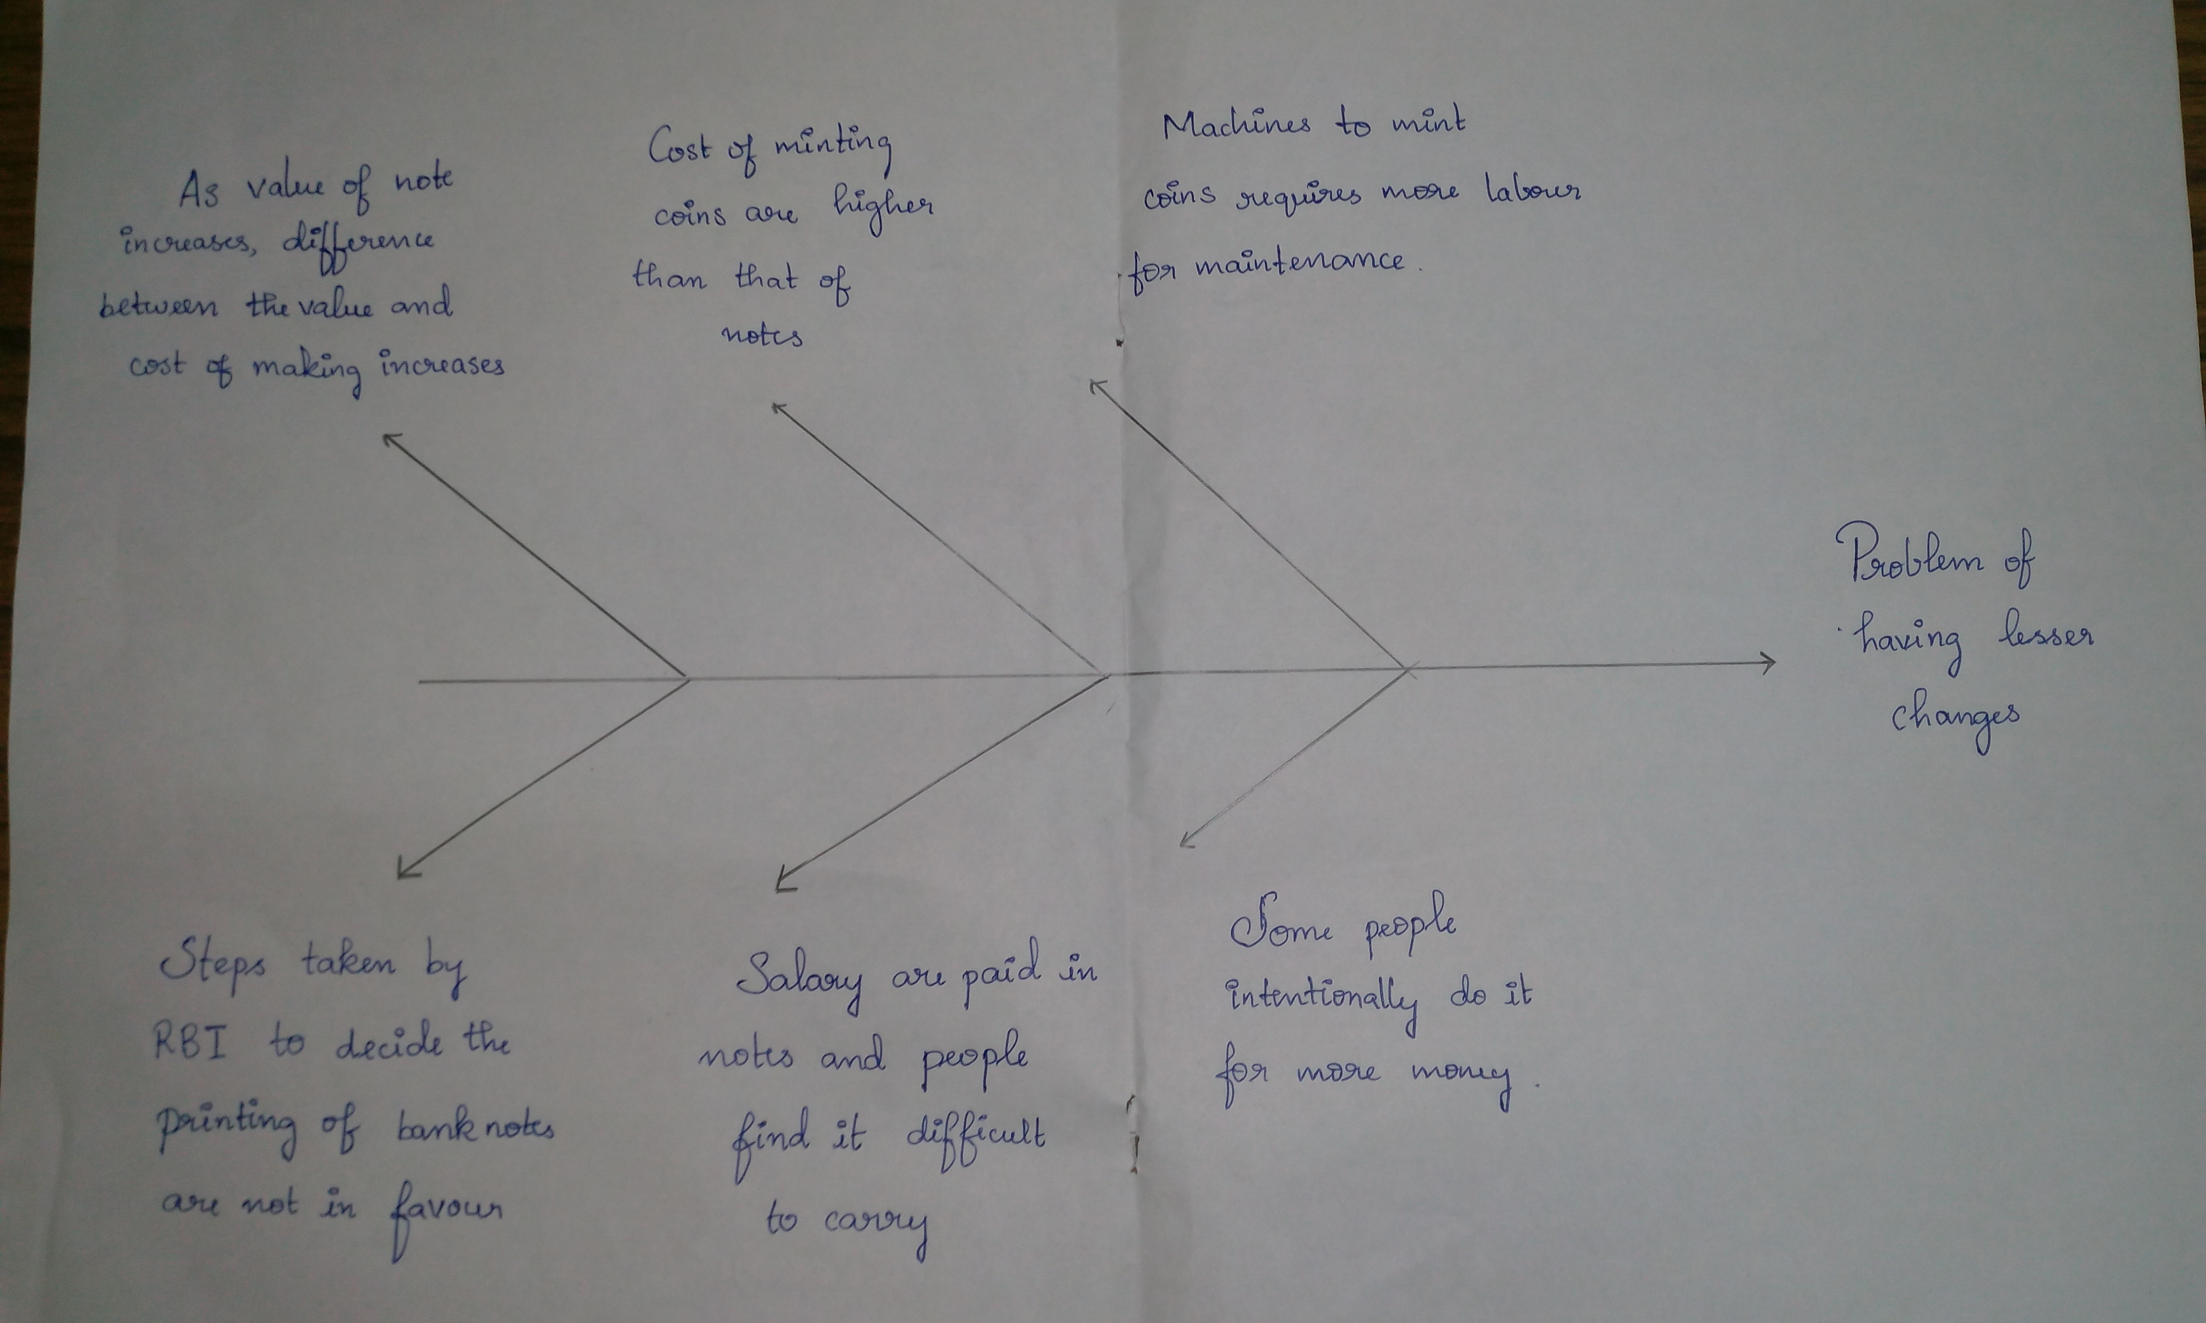

Slide 6
SOLUTION
Dial *ServiceProviderNumber#
Enter password
Confirm
In the ussd code enter amount
Re-enter amount

Slide 7
Market research - Feasibility
Since available at low cost, it is highly feasible.
Also, having a very simple interface, it is easy for everyone to use it.

Slide 8
MARKET RESEARCH- FINANCE
While developing the back end.
While spreading awareness.

Slide 9
Help Needed
BANK COLLABORATION
CELLULAR OPERATORS COLLABORATION
PUBLIC AWARNESS THROUGH DIFFERENT MEDIUMS

Slide 10
THANK YOU

